Slide 1

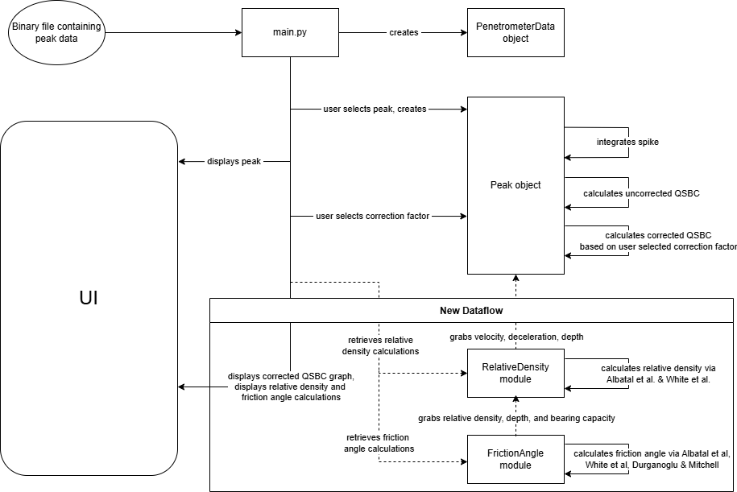
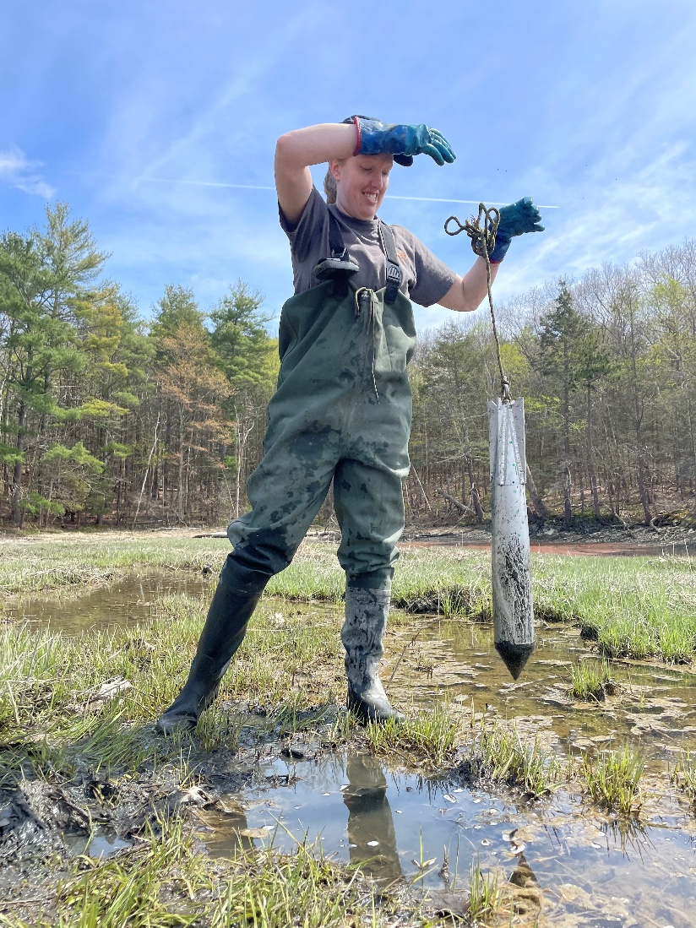
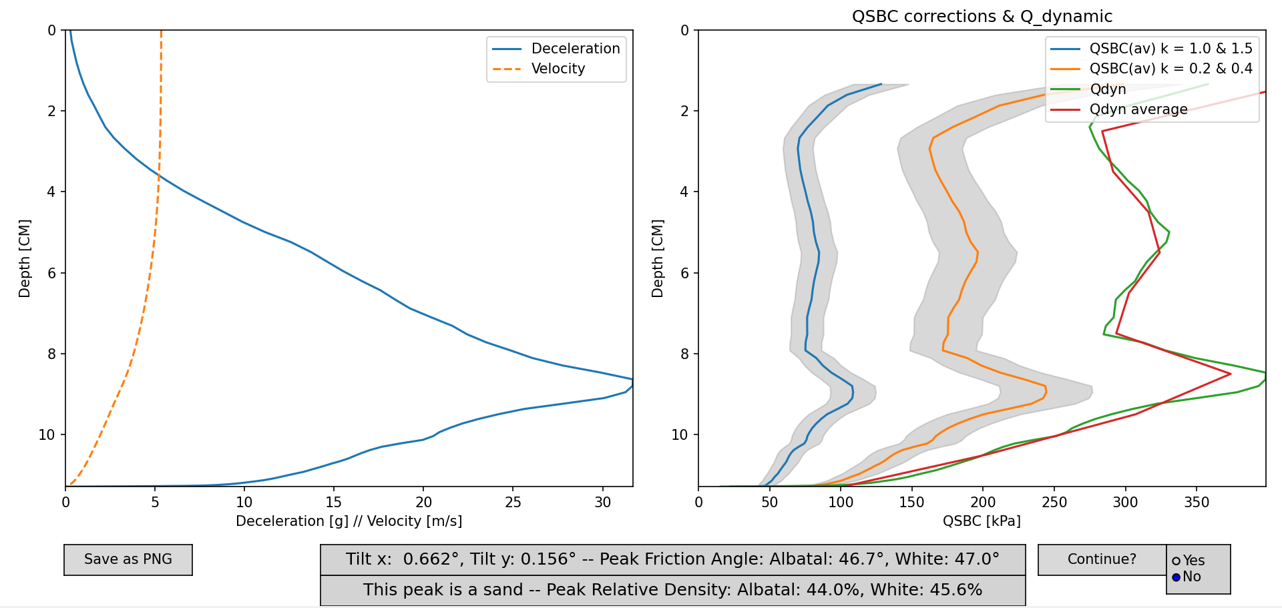
Free Fall Penetrometer Data Analysis Application
Vincent Ciccotelli, Rayya Burns, Brett Dupont, May Fallon, Troy Ciardelli-Zaryckyj, Anthony Snider
Department of Computer Science, University of New Hampshire
Introduction
Implementation
Testing
Free Fall Penetrometers (FFP) are small devices deployed from boats to measure soil strength and pore pressure. These measurements are further analyzed to characterize soil sediment, providing important data for offshore site development. The existing data analysis methods utilized by ocean researchers lack a graphical user interface, are spread across multiple tools and programming languages, and do not provide any validation of user input. Last year's development team created a desktop application that combined all existing data analysis functionality with a graphical interface.
Our project uses Python 3.10+ with NumPy, SciPy, Shapely, matplotlib, pandas, and Tkinter for computation, visualization, and GUI development. These tools were best for unifying all existing functionality in a modular way that is easy to understand and be improved on, and using Python was the best choice to allow the project to be packaged as a complete application.
We successfully generated and validated graphical outputs, ensuring consistency with existing MATLAB, Excel, and Python results by directly comparing graphs and numeric data. We have also created new unit tests to help future contributors change the code and ensure they do not introduce errors to the existing functionality. Soil relative density and friction angle calculations were tested against existing processed data provided by the project sponsor.
Design
A.
Evaluation & conclusion
Our goal was to refactor this application to incorporate relative density calculations, expansion of soil classification, friction angle calculation, and pore pressure properties. These features were implemented while maintaining the application’s efficiency, ease of interaction, and accuracy.
New data calculation and representation such as relative density and friction angle help provide the user a more centralized experience, preventing the need to perform these calculations outside of the application. Improvements to the display of quasi-static bearing capacity and other FFP data have increased clarity and improved the flow of the application. New values for users to input have boosted the flexibility and usability of the application tremendously, allowing users to experiment with plots. Additionally, input validation and plotting limits data entry errors and prevents them from corrupting a data analysis session. These factors allow ocean engineers to focus on the results of the data rather than the analytical process itself.​
Requirements
Functional:
All graphical data is saved to appropriately named .csv files
Analyze data using specified correction types
Outputs bearing capacity graph based on user-inputted values
Correctly classifies soil type based on penetration depth
Calculates relative density and friction angle for certain soil types
Analyze data to visualize pore pressure
Non-Functional:
Intuitive user experience with no terminal usage
Only valid inputs are processed
User input to data output is under three seconds
B.
Future Work
Implement additional penetrometer data analysis modules based on geotechnical strength properties
Add/improve upon soil characterization models
More complex and accurate models that consider variance of data; allowing user-input data at runtime
Models to predict more types of soil
Extend analysis of pore pressure data
ACKNOWLEDGMENTs
Data flow diagram illustrating how the system calculates relative density and friction angle, and presents the results with QSBC graph.
Image of User Interface after calculating Quasi-Static Bearing Capacity, Friction Angle, and Relative Density
Project Sponsor: Julie Paprocki
Faculty Advisor: Lisa Henry

Slide 2
Abstract
Free Fall Penetrometers are small devices deployed from boats to measure soil strength and pore pressure. These measurements are analyzed to characterize soil sediment, providing important data for offshore site development. Existing data analysis methods used by ocean researchers lack a graphical user interface, are spread across multiple tools and programming languages, and do not validate user input. Last year's development team produced a desktop application combining all existing data analysis functionality with a graphical interface.
Expanding upon the application's functionality, calculations were implemented and incorporated into the UI, including the White et al. and Albatal relative density calculations to extend soil classification functionality. These results were then tested against expected outputs from prior analysis to ensure accuracy. Feature development continued in the second semester with the addition of the friction angle calculations. The White et al., Albatal, and Jaber & Stark friction angle calculations were implemented in the UI and verified against the provided outputs. Furthermore, existing MATLAB code was modified and integrated into the application, incorporating pore pressure and tilt calculation features.
The result provides a more comprehensive application that extends soil classification and pore pressure features while maintaining the application’s efficiency, ease of use, and accuracy.

